Slide 1
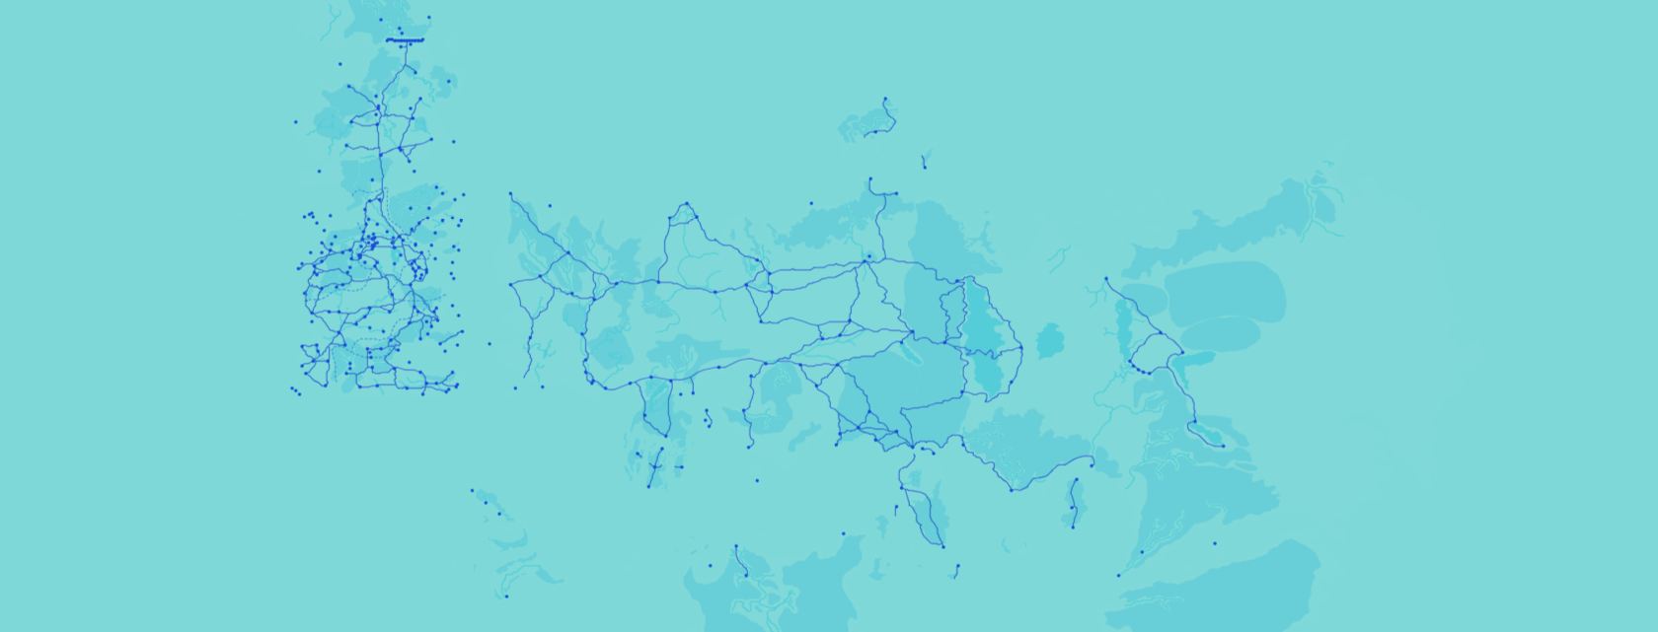


Slide 2
To play the Game of Ones please supply ONE thing your team did in the year that was new/different and that you consider to be an achievement, for each of the categories shown below..
ONE picture
ONE number
ONE story
ONE hashtag
ONE map
Please populate the following slides and add in some brief notes about what you did and why it was important . These will all contribute to my marketing session at the UC to show our achievements as ONE Esri

Slide 3
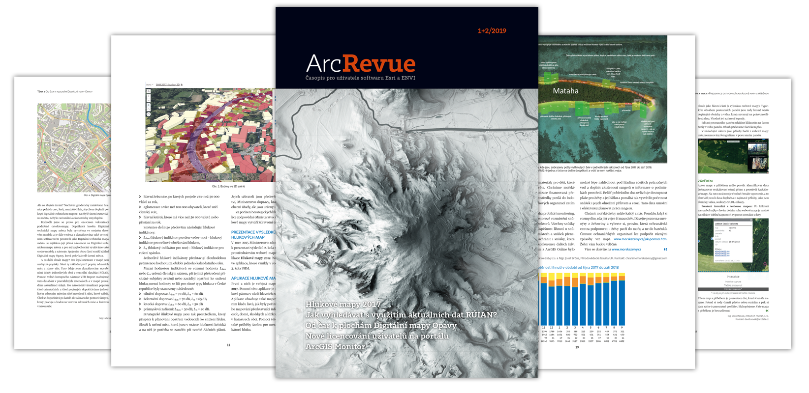
Picture
ArcRevue is a quarterly magazine we issue and send to our users for free. There has been no independent hardcopy GIS magazine in the Czech Republic for years, and there are none similar marketing magazines of the competitors too.
We manage to keep ArcRevue popular among GIS users with a right mix of case studies, technical articles and tips&tricks, positioning it as a magazine for Esri GIS users that helps them in their daily work. In the recent survey, up to 10 % of magazine‘s subscribers left us feedback, and this great number convinces us that readers truly care about ArcRevue.
This makes our company strong presence — we are the only ones who issues GIS magazine not only among commercial companies, but also in the whole Czech GIS community.

Slide 4
968 attendees
of 989 registrations, that‘s
Number
2,12 % mortality
of people attending our User Conference
We do really care about Czech User Conference. There is no event of comparable size in Czech Republic both in commercial and academic sphere. And people love it, return next year and the number of attendees is growing steadily, regardless on the economic situation overall.

Slide 5

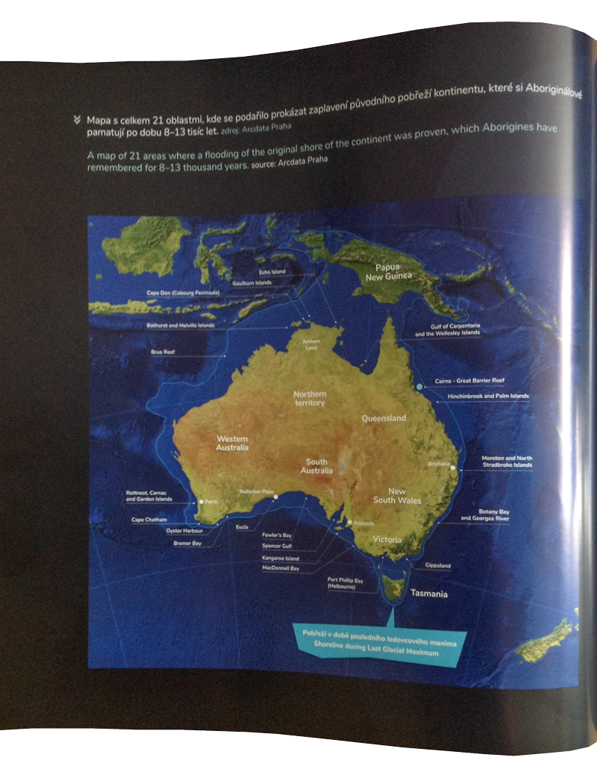
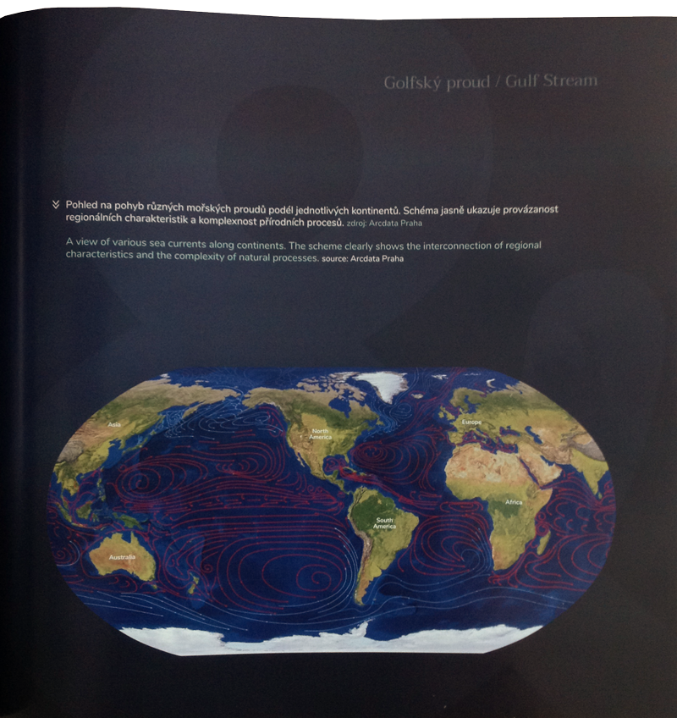
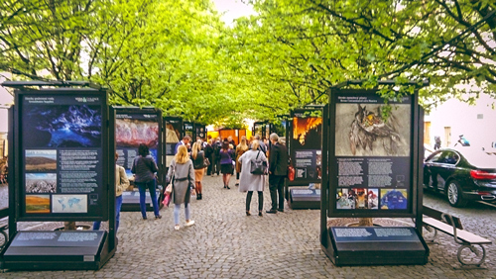
Story
Our cooperation with one of the famous egyptologist, prof. Miroslav Bárta, lead to our work on the exhibition Water & Civilization, authored by Czech and foreign scientific institutions, Scripps Institution of Oceanography, Scripps Center for Marine Archaeology and University of California, San Diego. The exhibition is now touring various Czech cities, USA and Israel.
We at ARCDATA PRAHA designed maps that accompany the exhibition. We believe that the exhibition is unique in the number of discussed themes which help the public to understand the changes our environment is undergoing and to help them to raise awareness of sustainable life. The vernissage of the exhibition was visited by Czech prime minister and a number of ministers.

Slide 6
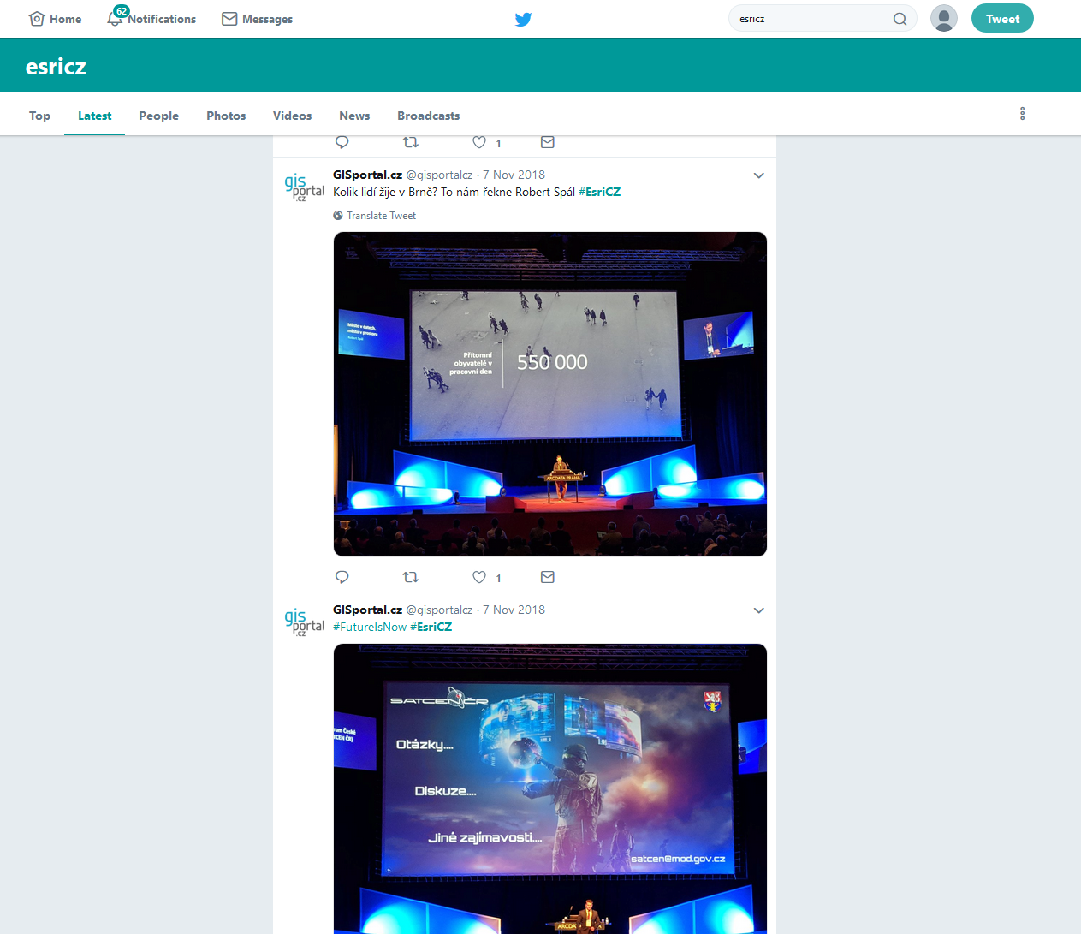
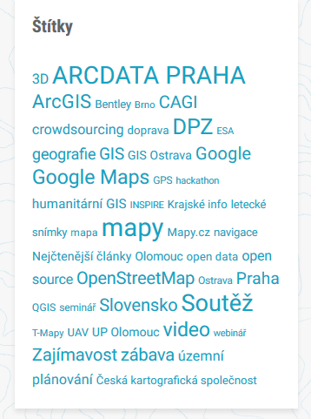
Hashtag
#EsriCZ
This hashtag marks tweets about Czech User Conference, but in our minds also represents ongoing partnership with GISportal.cz, the most popular GIS news website in Czech Republic. ArcGIS and ARCDATA PRAHA are one of most frequent keywords in their articles and the hashtag #EsriCZ is used in their live Twitter news from Czech UC.

Slide 7
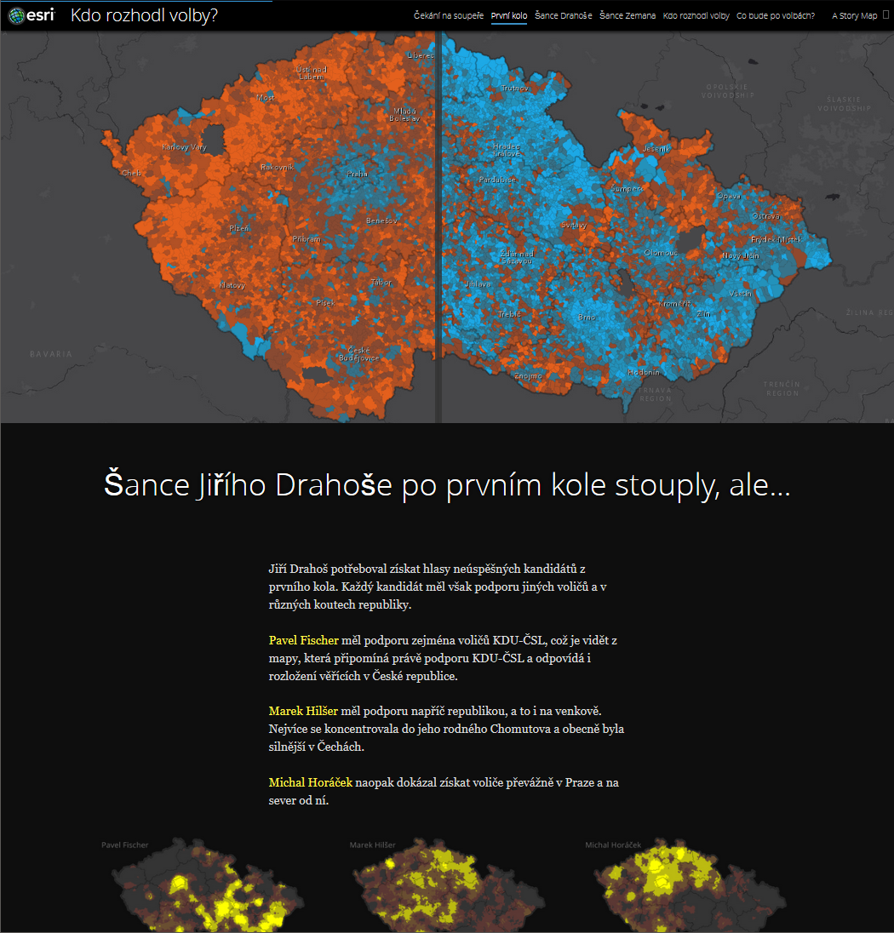
Map
We created this Story Map in cooperation with leading Czech political scientists. It analyses Czech presidential elections 2018, concerning spatial sociodemographic analyses, hotspots etc., but in a way that is easily understandable for common reader.
The map was popular and we learned a lot – not only in creating complex storymaps, but also in communication with mainstream media.
You can check the map at www.arcdata.cz/volby2018, but its not in English, sorry.

Slide 8
Thank You for playing the

